Slide 1
LEARNING ALGORITHMS + SHAPE GRAMMARS
PRESTON PAPE

Slide 2
Machine Learning Techniques for ADU Design
Can the use of a machine learning computational design tool allow for greater access to constructing ADUs, thereby combating the housing crisis in the United States?
What has been done so far at this intersection between machine learning and housing?
Are shape grammars and/or expert systems the correct means to utilize machine learning for architectural design?

Slide 3
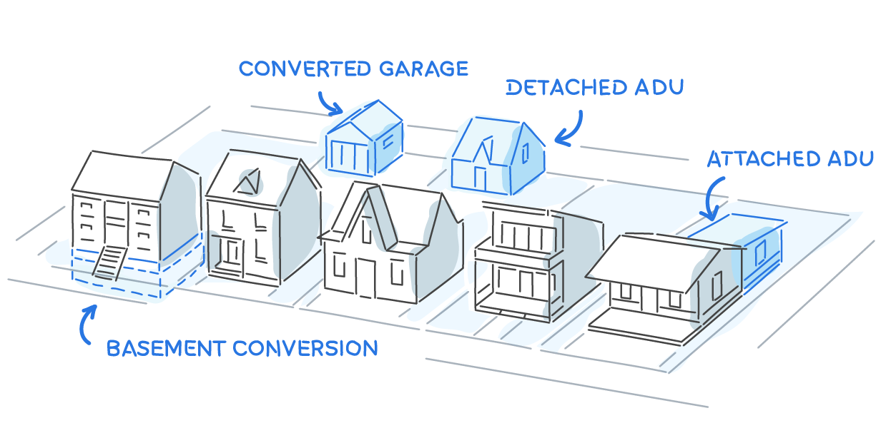
https://www.housable.com/city/sacramento-ca-179074

Slide 4
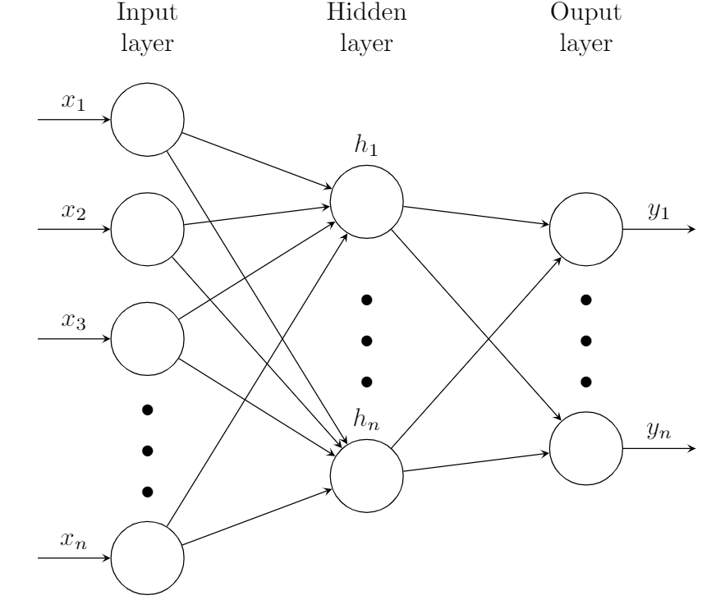

Core Concepts
Machine Learning
Shape Grammars
https://tex.stackexchange.com/questions/497859/neural-network-diagram
https://www.jstor.org/stable/1424823

Slide 5
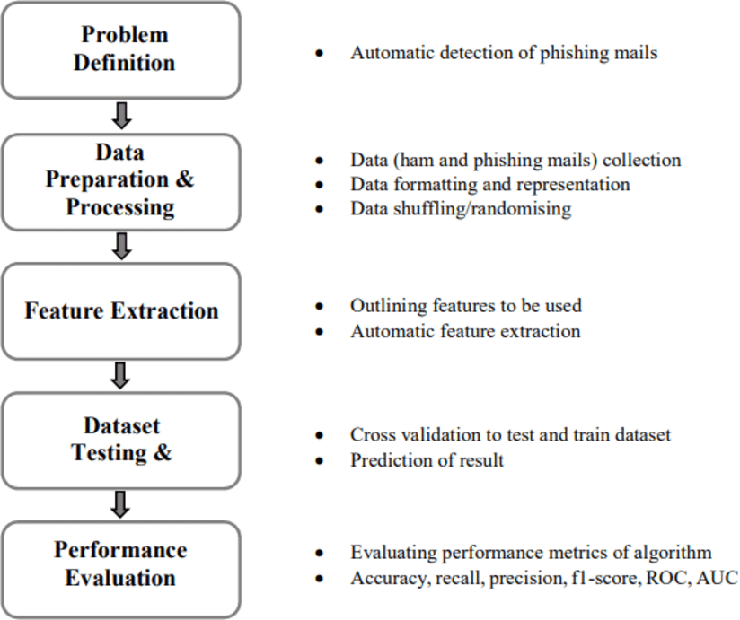
CONCEPT: Machine Learning
algorithms that can complete tasks for which it was not programmed explicitly
large data sets
advanced/wicked problems
AI vs ML
https://www.researchgate.net/figure/Steps-carried-out-in-the-machine-learning-process_fig1_329498533

Slide 6
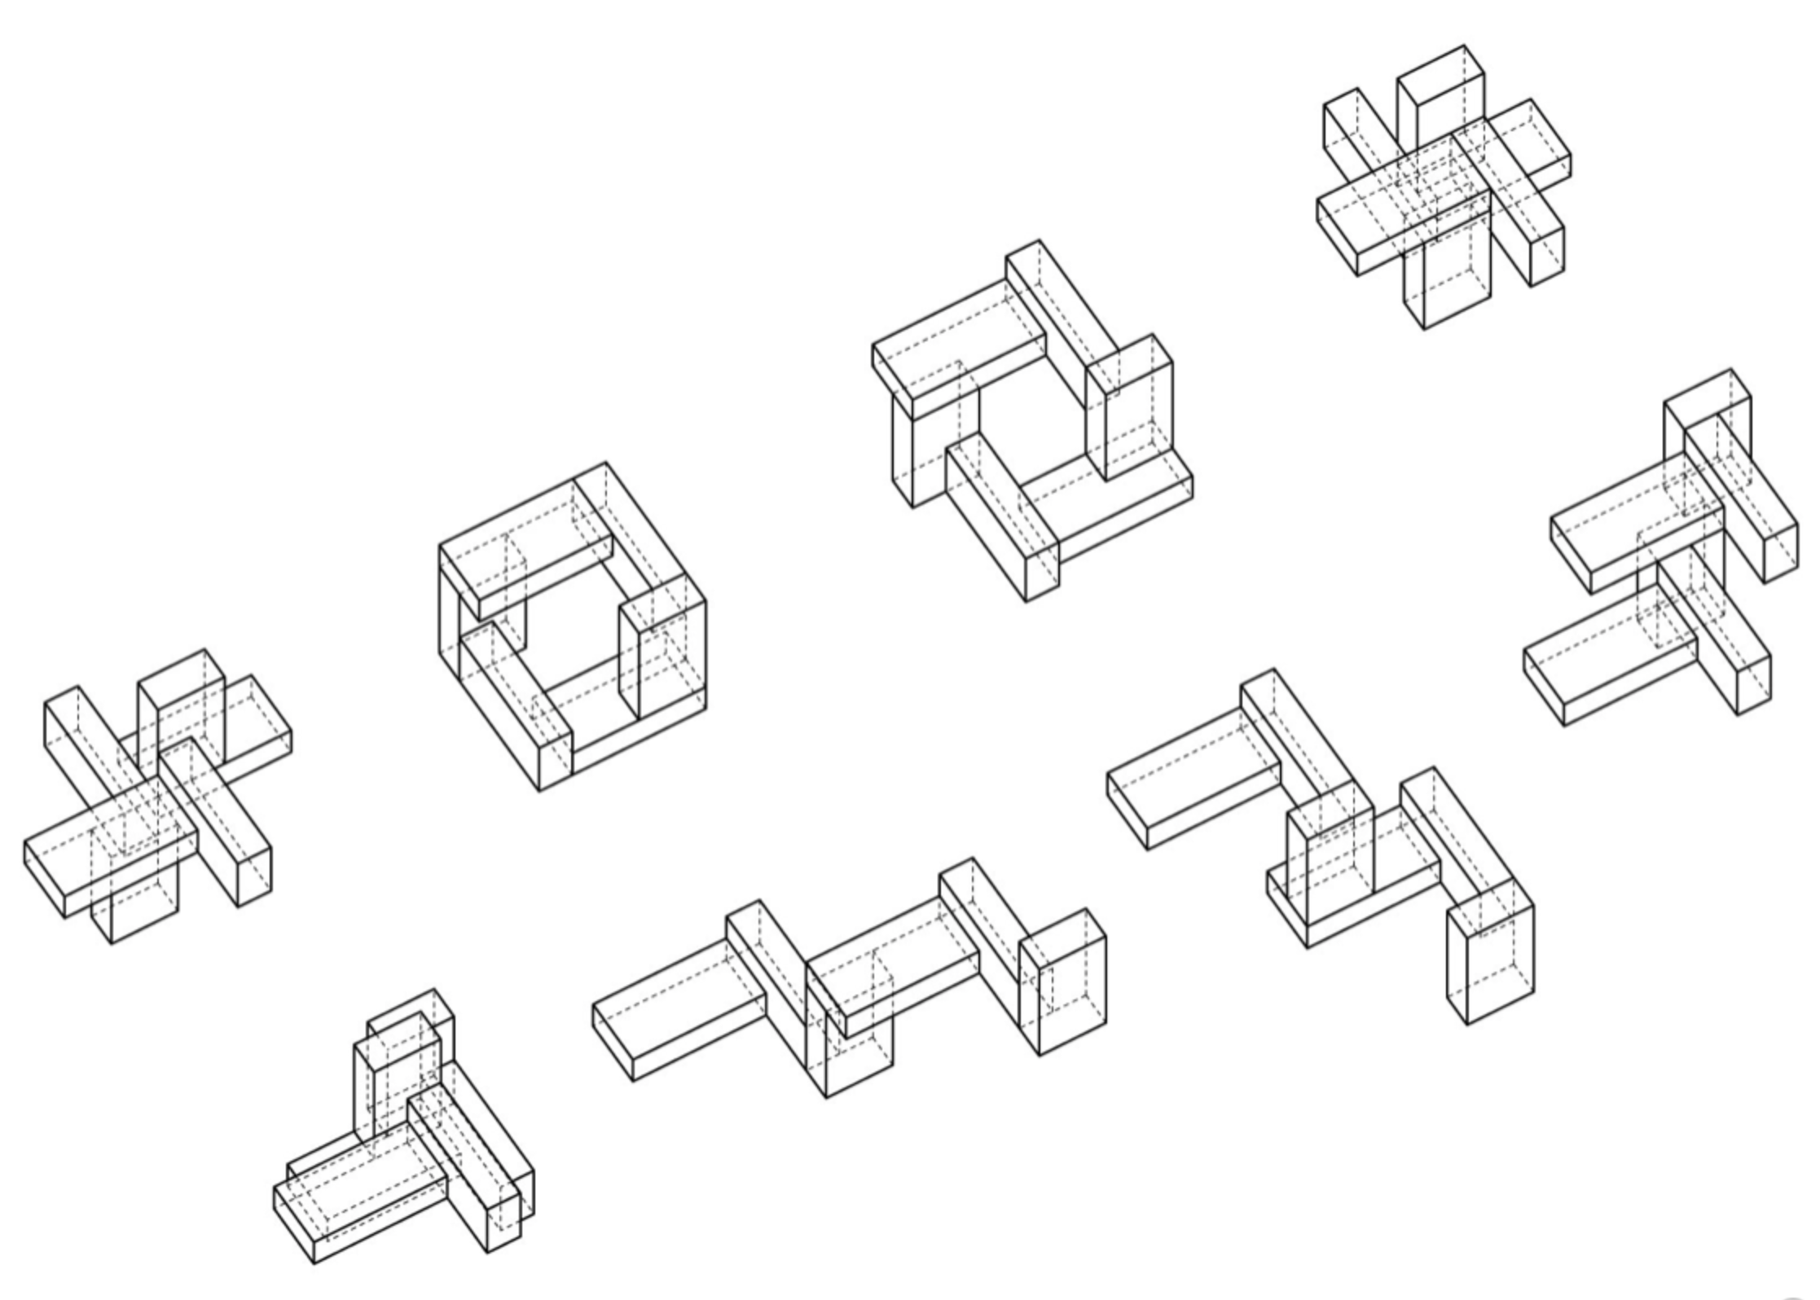
CONCEPT: Shape Grammars
geometric permutation
rule-based system
shape rules vs. generation engine
traditional: rotation, reflection, scaling, translation
taken further: parametric and self-referential
http://grape.swap-zt.com

Slide 7

GOOGLE TENSORFLOW
Open source framework for machine learning
Compatibility + operability
Looking into inputs/outputs
https://www.tensorflow.org/site-assets/images/marketing/resources/models-hero.svg?authuser=1

Slide 8
THANK YOU

